Slide 1
Extend app to use Mongo
Still using:
http://cwbuecheler.com/web/tutorials/2013/node-express-mongo/
We are using cloud mlab.com mongodb, so will skip parts about installing mongodb as a local db on our “server”

Slide 2
Go to mlab.com and
Create a new collection, call it
Usercollection
Then add some records (documents)
{
"username" : "testuser1",
"email" : "testuser1@testdomain.com"
}
{
"username" : "testuser2",
"email" : "testuser2@testdomain.com"
}
{
"username" : "testuser3",
"email" : "testuser3@testdomain.com"
}
Mongo will auto create keys, similar to SQL
"_id" : ObjectId("5202b481d2184d390cbf6eca")

Slide 3
Connecting MONGO TO NODE
We will build a page where the JS in the route on the Node server reads our DB entries and then inserts those values into a jade view page.
This is the new effect we are looking for the client to see from the server
<ul>
<li><a href="mailto:testuser1@testdomain.com">testuser1</a></li>
<li><a href="mailto:testuser2@testdomain.com">testuser2</a></li>
<li><a href="mailto:testuser3@testdomain.com">testuser3</a></li>
</ul>

Slide 4
Add in app.js file for mongo
These lines enable our app to talk to MongoDB (we're going to use Monk to do it), and where our database is located.
// Find this existing code
var bodyParser = require('body-parser');
// New code that knows mongo and a nice abstraction layer
var mongo = require('mongodb');
var monk = require('monk');
// article says to add this, but we are using
// var db = monk('localhost:27017/nodetest1');
// instead, we will add a connection string to mlab.com
mongodb://<user>:<pw>@ds053658.mlab.com:53658/somedb
var db = monk('mongodb://<user>:<pw>@ds053658.mlab.com:53658/somedb');
(See that PowerPoint for setting up the cloud mlab.com database )

Slide 5
More changes to app.js
Find these 2 lines, and then insert BEFORE them
// Make our db accessible to our router
app.use(function(req,res,next){
req.db = db; // db is what we just created prior slide
next();
});
// find these lines, insert the above them
app.use('/', routes);
app.use('/users', users);
By adding this function to app.use, we're adding that object to every HTTP request (ie: "req") our app makes. Note: this is probably sub-optimal for performance but, again, we're just learning.

Slide 6
http://expressjs.com/en/guide/using-middleware.html
Application-level middleware: Bind application-level middleware to an instance of the app object by using the app.use() and app.METHOD() functions, where METHOD is the HTTP method of the request that the middleware function handles (such as GET, PUT, or POST) in lowercase. req is the request object. res is the response object. Next is to connect this to any other url route that “matches”
This example shows a middleware function with no mount path. The function is executed every time the app receives a client request for any URL (route) of any method type.
var app = express()
app.use(function (req, res, next) {
console.log('Time:', Date.now())
next()
})
This example shows a middleware function mounted on the /user/:id path. The function is executed for any type of HTTP request on the /user/:id path.
app.use('/user/:id', function (req, res, next) {
console.log('Request Type:', req.method)
next()
})
This example shows a route and its handler function (middleware system). The function handles GET requests to the /user/:id path.
app.get('/user/:id', function (req, res, next) {
res.send('USER')
})

Slide 7
Edit \routes\index.js
This js is what node executes for you when a client directs to host/index (or just host/ as index is the default)
It has the basic index route, now we will add a second one.

Slide 8
Adding another route for a get to /userlist
/* GET Userlist page. */
router.get('/userlist', function(req, res) {
var db = req.db;
var collection = db.get(‘Usercollection');
collection.find({},{},function(e,docs){
res.render('userlist', {
"userlist" : docs
});
});
});
"userlistdata” maybe? I hate when they use the same name for 2 different things!
This gets the "db" object we passed to our http request,
and then use that db connection to fill our "docs" variable with
database documents, ie: user data. It specifies which collection in the db we want,
and does a find, then returns the results as the variable "docs". (e holds errors)
Then do a render of userlist (with a corresponding Jade template),
giving it the userlist variable to work with,
and passing our database documents ( docs ), to that variable.
So now we need a jade template.

Slide 9
Go to views folder, create a userlist.jade file
This code uses the same
Name: “userlist” here:
res.render('userlist', {
"userlist" : docs
Which I think is confusing. I
Would have done
res.render('userlist', {
“returnedlist" : docs
In that code, and then that same name
here
extends layout
block content
h1.
User List
ul
each user, i in userlist
li
a(href="mailto:#{user.email}")= user.username
We've also got the count – i – handy in case we need it, though in this instance we don't.

Slide 10
Getting the following error?
{ [Error: Cannot find module '../build/Release/bson'] code: 'MODULE_NOT_FOUND' } js-bson: Failed to load c++ bson extension, using pure JS version
First off, don't worry! You can still run your node application even when seeing this error. Basically, what's happening is: during the initial "npm install" process, the MongoDB module tried to create a couple of files using Python v2.7. If you don't happen to have that installed (even if you have a higher version of Python, it won't work), then it can't build the files, so it falls back on a JavaScript-driven system instead. This system works just fine, but in a production environment with a lot of data handling, it can be slow, so it's better to have the binaries.
If you want to get rid of the error, follow these steps:
Install Python 2.7 (this will not impact existing Python 3.x installs).
Delete your node_modules directory and everything in it.
Re-run npm install in your nodetest1 directory from the command line.

Slide 11
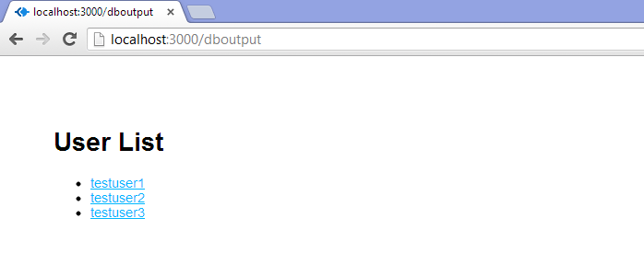
open your browser to http://localhost:3000/userlist
Should see this:

Slide 12
Ok, we read, now lets write from the client to the server to Mongo
We need to set up a route that takes a POST, rather than a GET
Start by adding another route for a new add user form to be sent to down to the client
Open /routes/index.js and add the following code above the last module.exports line:
/* GET New User page. */
router.get('/newuser', function(req, res) {
res.render('newuser', { title: 'Add New User' });
});

Slide 13
Again we need a new jade file
Open up /views/ and add new one, newuser.jade
extends layout
block content
h1= title
form#formAddUser(name="adduser",method="post",action="/adduser")
input#inputUserName(type="text", placeholder="username", name="username")
input#inputUserEmail(type="text", placeholder="useremail", name="useremail")
button#btnSubmit(type="submit") submit
a form with the ID "formAddUser“, Method is post, action is adduser
two ugly, unstyled text inputs and a submit button. 1996-style

Slide 14
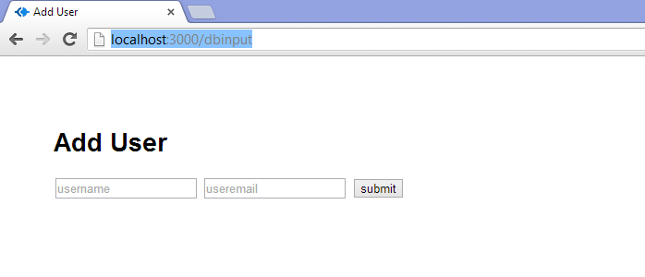
restart your node server
and go to http://localhost:3000/newuser
you'll see your form
If you submit it, you will get a 404 error

Slide 15
Go back to /routes/index.js and let's create our insertion function
put the code on the next page above the final module.exports line

Slide 16
/* POST to Add User Service */
router.post('/adduser', function(req, res) {
// Set our internal DB variable
var db = req.db;
// Get our form values. These rely on the "name" attributes
var userName = req.body.username;
var userEmail = req.body.useremail;
// Set our collection
var collection = db.get('Usercollection');
// Submit to the DB
collection.insert({
"username" : userName,
"email" : userEmail
}, function (err, doc) {
if (err) {
// If it failed, return error
res.send("There was a problem adding the information to the database.");
}
else {
// if good, forward to success page, userlist to show updated data
res.redirect("userlist");
}
});
});
In real world you would want more validating, error-checking, etc.
You'd want to check for duplicate usernames and emails, for example.
And to vet that the email address at least looks like a legit entry.

Slide 17
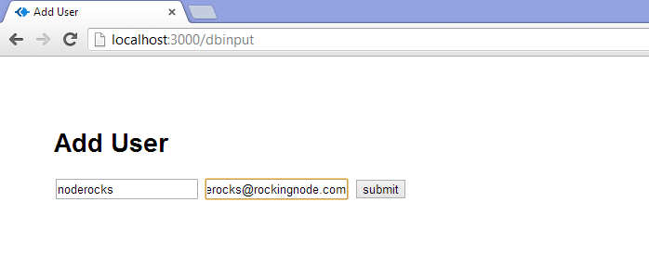
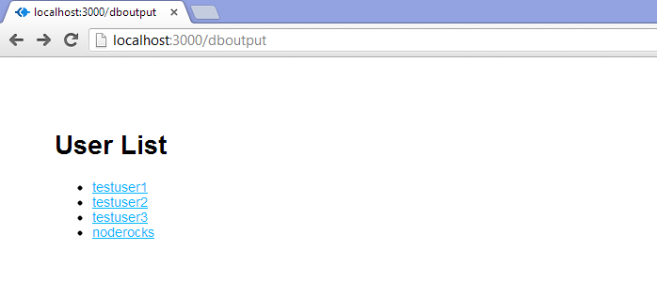
Should work now

Slide 18
“Congratulations. Seriously. If you followed this all the way through, and if you really paid attention to what you were doing and didn't just paste code, you should have a really solid grasp on routes and views, reading from the DB, and posting to the DB. That is all you need to get started developing whatever app you want to build. I don't know about you, but I think that's really cool.” Christopher Buecheler
Claims he is an autodidact polymath, which is an incredibly pretentious way of saying that he's a jack of all trades

Slide 19
Should the Server JS get the data and send it down, or should the client do it itself??
You could very easily change your userlist view from an Express-driven web page complete with Jade template to a plain old JSON response. You could then access this with AJAX and manipulate it on the client-side, with jQuery for example, instead of on the server side. In fact, I wanted to cover that so badly that I wrote an entire second tutorial on it.
Creating a Simple RESTful Web App with Node.js, Express, and MongoDB.

Slide 20
Article points to more things
Using mongoose
https://www.kompulsa.com/introduction-mongoose-storing-data-mongodb/
It's bigger than Monk, but it also does more.
You could check out Stylus, the CSS preprocessor that comes with Express.

